Slide 1
TEAM
▣
PLAYBOOK
TEAM CREST
NLA TEAM · 2026-27
Axpo Volley Näfels

Slide 2
TEAM PLAYBOOK
CREST
Index
01
Team Identity
02
Playing Principles
03
Offensive System
04
Defensive System
05
Blocking System
▣
06
Serve
TEAM PHOTO — replace
07
Reception
08
Error Management
09
Game Plan
10
KPIs & Metrics
11
Common Language
AXPO VOLLEY NÄFELS · TEAM PLAYBOOK 2025-26
02

Slide 3
01
WHO WE ARE
CREST
Team Identity
We are a team defined by:
Intensity in every action
Tactical and emotional discipline
Clear, constant communication
▣
Individual and collective responsability
PHOTO — replace
Competitive humility
Professionalism on and off the court
Relentless pursuit of improvement
Winning mentality
AXPO VOLLEY NÄFELS · TEAM PLAYBOOK 2025-26
03

Slide 4
02
THE FRAMEWORK
CREST
Playing Principles
Our principles drive every action in training and competition.
Tactical clarity: every player owns their role and priority in each situation.
Smart aggression: we attack and defend with intent, never losing control.
Setting tempo: we speed up execution while holding precision and court awareness.
System discipline: we respect the pre-set structure for clean execution.
Reading the game: we interpret the context to decide with an edge.
Role responsibility: discipline and consistency in every function.
Emotional stability: we train the way we play — always at 100%.
AXPO VOLLEY NÄFELS · TEAM PLAYBOOK 2025-26
04

Slide 5
03
HOW WE SCORE
CREST
Offensive System
Rotation-based setting: we adjust the set to where the pass drops, shifting systems to create numerical advantage against the block.
Middle involvement: middles are a constant threat in side-out and transition, with varied tempos and trajectories.
Tempo variability: we adapt set height and speed to ball quality to manage our attack.
Aggressive transition: we convert the counter-attack through set quality and disciplined hitting.
The block as a tool: more than an end, it steers the rival attack into our strong defensive zones.
Setter leadership: offensive rhythm, smart shot selection and balanced distribution by rotation, read and context.
Hitter efficiency: variety of shots, tools and decisions — detecting a tactical error from a technical one.
Hit hard, high and long, varying angles and never closing the swing.
Be smart: recycle when needed and always target the last 3 meters of the court.
AXPO VOLLEY NÄFELS · TEAM PLAYBOOK 2025-26
05

Slide 6
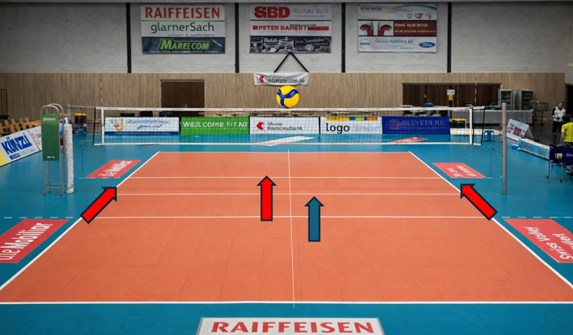
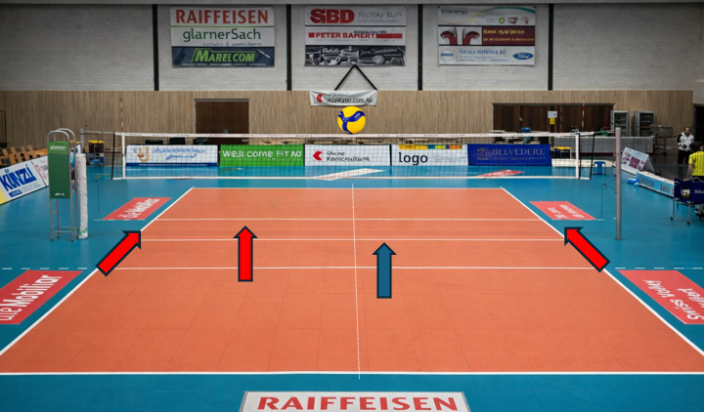
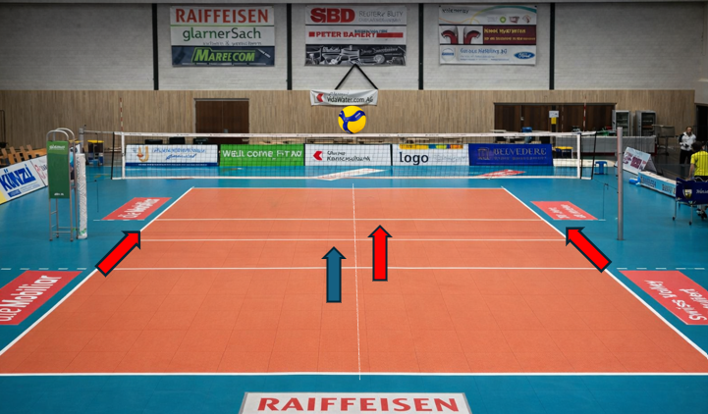
03
IN-SYSTEM ATTACK
Offensive System
RECEPTION IN 3 — four attacking options, two hitters per half court
Middle close · Pipe behind
Middle shoot · Pipe behind
Middle behind · Pipe close
▣
▣
▣
COURT IMAGE
COURT IMAGE
COURT IMAGE
AXPO VOLLEY NÄFELS · TEAM PLAYBOOK 2025-26
06

Slide 7
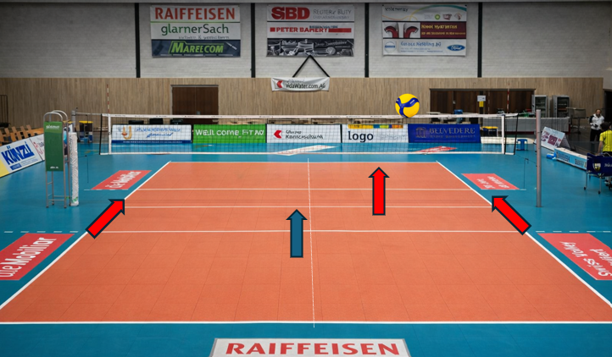

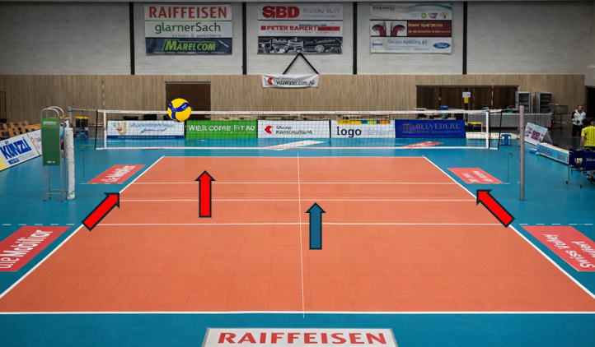
03
OUT-OF-PERFECT ATTACK
Offensive System
RECEPTION 2-3 — 4 options, 2 hitters/half
RECEPTION 3-4 — 4 options
Middle close · Pipe over
Middle shoot · Pipe close
Middle behind · Pipe behind
▣
▣
▣
COURT IMAGE
COURT IMAGE
COURT IMAGE
AXPO VOLLEY NÄFELS · TEAM PLAYBOOK 2025-26
07

Slide 8
04
HOW WE DEFEND
CREST
Defensive System
The block as a tool: more than a direct kill, we guide the rival attack into the zone where our defenders wait.
System organization: we defend on pre-set patterns by rotation, rival tendencies and the opposing setter's distribution.
Collective reading: we trigger the system off the rival pass and move with the opposing set.
Dig-to-attack: after the dig we look for a fast, orderly transition into real counter-attack options.
Role responsibility: each player owns their defensive job with discipline, communication and technical precision.
Controlled aggression: we defend with intent, keeping body balance, controlled rebounds and rally continuity.
No ball hits the floor without our players first going after it.
AXPO VOLLEY NÄFELS · TEAM PLAYBOOK 2025-26
08

Slide 9
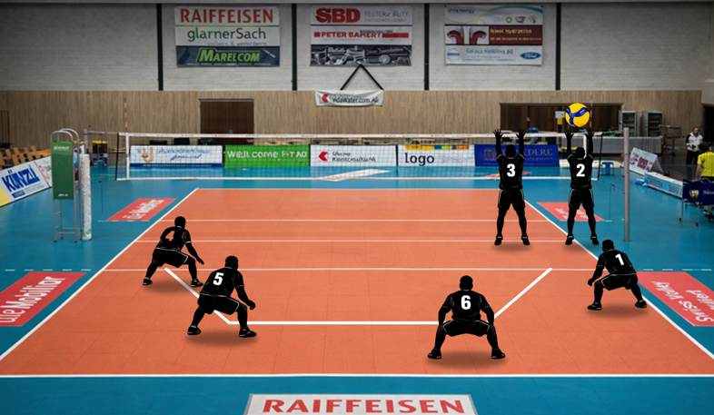
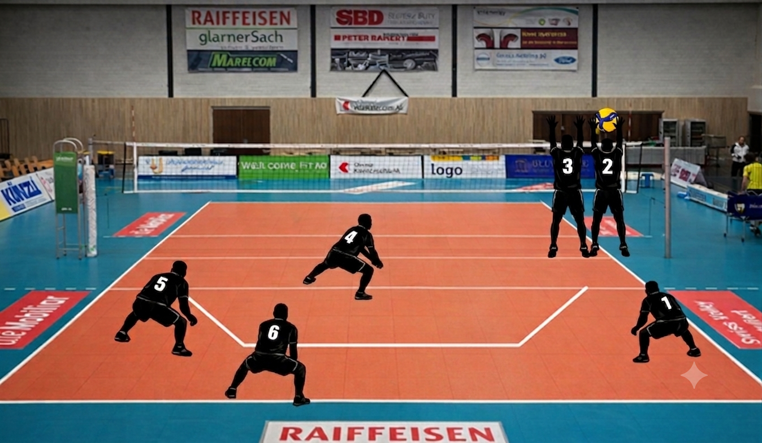
04
DEFENSIVE POSITIONS
CREST
Defensive System
QUICK · x4
HIGH · x4
▣
▣
COURT IMAGE — replace
COURT IMAGE — replace
Pos 6 — block hole: read & move
Pos 5 — deep cross: facing the hitter
Pos 1 — line: tips & tempo changes
Pos 4 — sharp angle
Pos 6 — double cross (unless exception)
Pos 5 — deep cross: facing the hitter
Pos 1 — line: tips & tempo changes
Pos 4 — sharp angle
AXPO VOLLEY NÄFELS · TEAM PLAYBOOK 2025-26
09

Slide 10
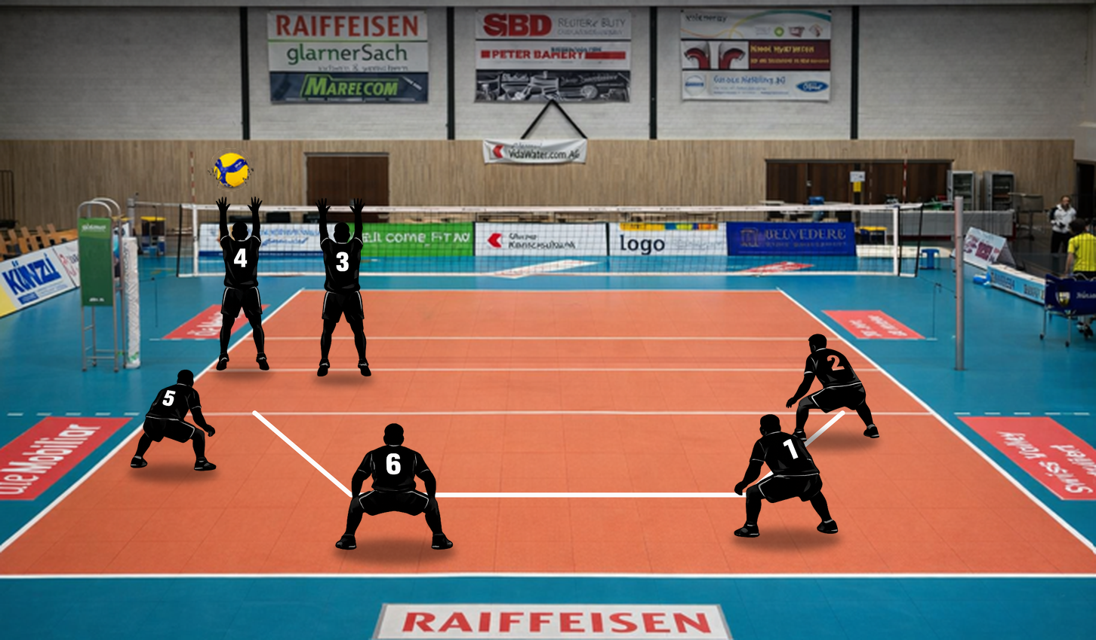
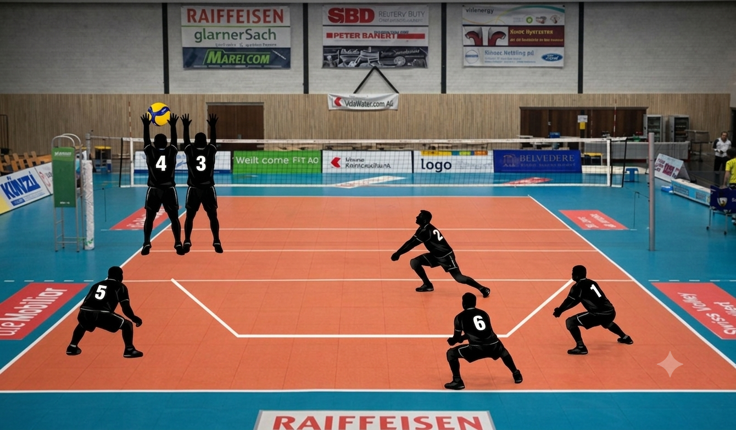
04
DEFENSIVE POSITIONS
Defensive System
QUICK · x2
HIGH · x2
▣
▣
COURT IMAGE — replace
COURT IMAGE — replace
Pos 6 — block hole: read & move
Pos 1 — deep cross: facing the hitter
Pos 5 — line: tips & tempo changes
Pos 2 — sharp angle
Pos 6 — double cross (unless exception)
Pos 1 — deep cross: facing the hitter
Pos 5 — line: tips & tempo changes
Pos 2 — sharp angle
AXPO VOLLEY NÄFELS · TEAM PLAYBOOK 2025-26
10

Slide 11
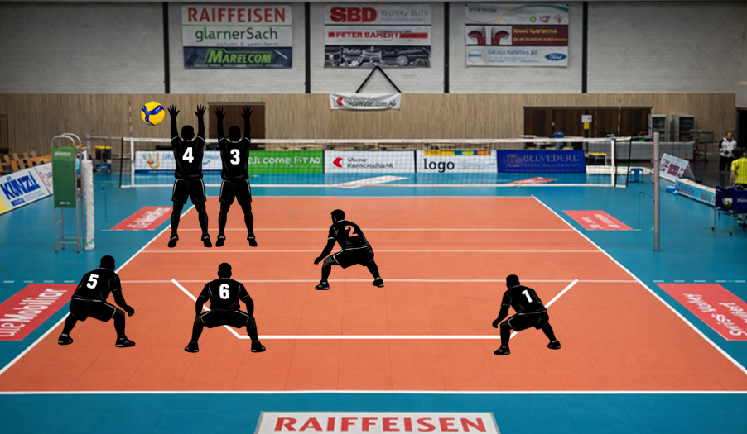
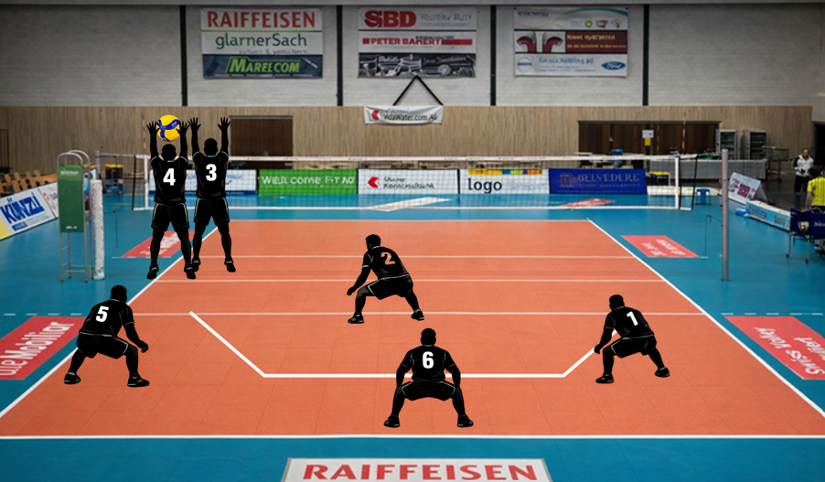
04
DEFENSIVE POSITIONS
CREST
Defensive System
QUICK · x1
HIGH · x1
▣
▣
COURT IMAGE — replace
COURT IMAGE — replace
Pos 6 — double line: read & move
Pos 1 — deep angle: facing the hitter
Pos 5 — ball line
Pos 2 — tip behind the block
Pos 6 — court center (unless exception)
Pos 1 — deep angle: facing the hitter
Pos 5 — ball line
Pos 2 — tip behind the block
AXPO VOLLEY NÄFELS · TEAM PLAYBOOK 2025-26
11

Slide 12
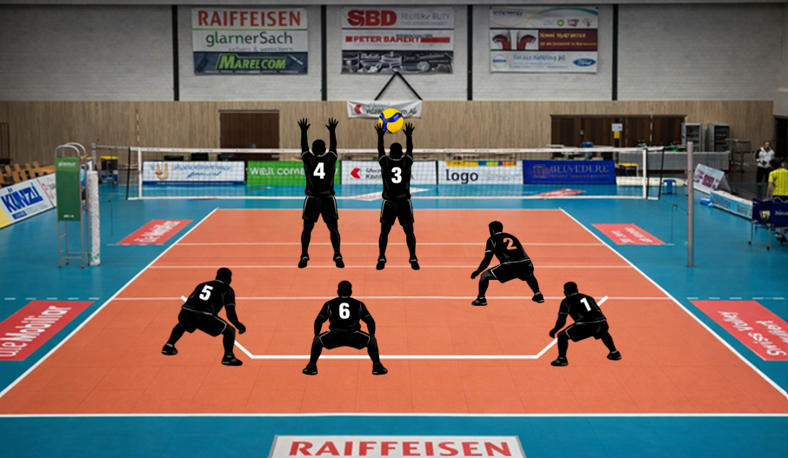
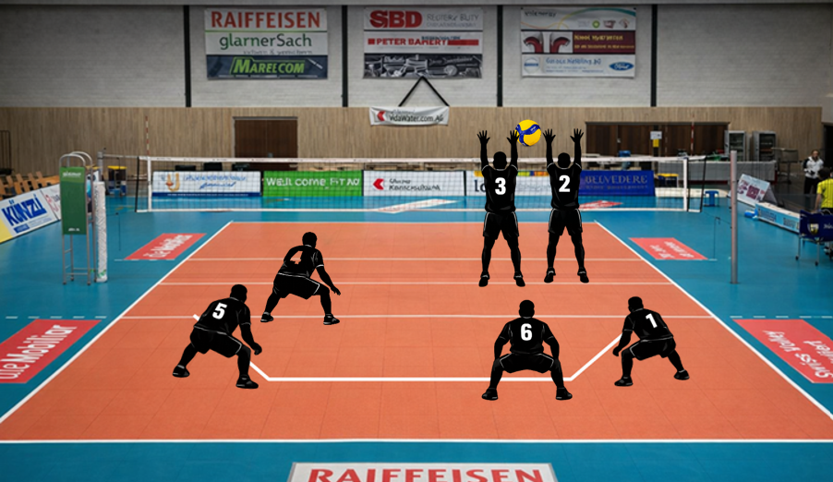
04
DEFENSIVE POSITIONS
CREST
Defensive System
CLOSE
SHOOT
▣
▣
COURT IMAGE — replace
COURT IMAGE — replace
Pos 5 — facing the middle
Pos 6 — shift left (6-5)
Pos 1 — outside the block
Pos 4 — help (if possible)
Leave the lines — defend deep & tight
Pos 1 — facing the middle
Pos 6 — shift right (6-1)
Pos 5 — outside the block
Pos 2 — help (if possible)
Free the lines — defend deep & tight
AXPO VOLLEY NÄFELS · TEAM PLAYBOOK 2025-26
12

Slide 13
05
SIDE-OUT + TRANSITION
CREST
Blocking System
R
Read decision by rival trajectory and setter distribution.
1
Call 1 priority front half (middle · pipe · position 4).
2
Call 2 priority back half (middle · pipe · position 2/1).
3
Commit we follow the middle; on a perfect ball we block 1-on-1.
4
Pin & pin priority on the wings.
We block the ball, not a zone. ◦ VIDEO
The pin takes the ball; the middle closes mainly the cross-court.
The off-blocker drops fast to cover the sharp angle.
We watch: pass drop, set direction, ball path and the hitter's approach.
Ball quality changes the block — a double-positive isn't a high, separated ball. Good reading sets jump timing and contact. We set defensive position before the rival contact.
THE DEFENSE CALLS OUT WHEN THERE IS NO BLOCK.
AXPO VOLLEY NÄFELS · TEAM PLAYBOOK 2025-26
13

Slide 14
06
CONCEPT & SYSTEM
CREST
Serve
MINDSET
MAIN OBJECTIVES
We are aggressive from this fundamental. The serve is our first real chance to win the point — executed with intent, pressure and weaknesses of the rival.
Jump serve → ace. Float → hurt or neutralize a specific passer per game plan. First serve of each set and post-timeout: must be in. Stay flexible to what the team needs.
RISK SYSTEM — 3-3 MODEL
FLOAT SERVE
Group A (3 players): 85–100% risk, constant damage. Group B (3 players): 70–85% risk, tactical control without losing aggression.
Always tactical — aimed at zones or specific passers. Aggressive, with unstable trajectory and reading of the rival system.
JUMP-SPIN SERVE
ERROR & RISK MANAGEMENT
Full: total commitment and confidence, deep to court center. Controlled: in, aimed at a scouted zone.
Max 4 errors per set (does not license raising risk above profile). No two missed serves in a row. Individual risk is set before each match — master more than one serve from any spot.
AXPO VOLLEY NÄFELS · TEAM PLAYBOOK 2025-26
14

Slide 15
07
CONCEPT & SYSTEM
CREST
Reception
GENERAL PRINCIPLES
Neutralize the rival serve and deliver a high, stable, centered ball so the setter keeps two real options. The system depends on our passers' profile and the rival serve. Push the lines up and shrink the court on floats to pass overhead.
VS JUMP-SPIN SERVE
Firm platform, body aligned behind the ball, no hip rotation or loose arms. 3-passer system with constant zone communication. Setter and middle alert to the short serve and net deflections. Goal: height + control, always to ZONE 3.
VS FLOAT SERVE
Two main passers with high responsibility. We shrink the front pin's zone to free him to attack. Ready to pass sideways, opening hips and lifting the platform. Overhand passing enabled.
FLEXIBILITY & ADAPTABILITY
Systems are dynamic tools: they shift by rotation, momentum, performance or serve type. We use whatever combination works best for the team at that moment.
AXPO VOLLEY NÄFELS · TEAM PLAYBOOK 2025-26
15

Slide 16
08
PLAY FREE
CREST
Error Management
The error is information. It never stops aggression. Always have a reason why.
TECHNICAL ERROR → gesture execution
TACTICAL ERROR → decision in context
A hard, deep hit is a good error; a block-out on a high ball from closing the swing is a bad one — technical and tactical.
TEAM KEY Play aggressive, with intent and no fear of failing.
CRITICAL MOMENTS
Under pressure, we simplify.
Brief communication, no noise.
Ball security — from the freeball, always through Zone 3, up to set quality.
Highest-probability attack.
Clear roles — we listen to the staff and execute.
AXPO VOLLEY NÄFELS · TEAM PLAYBOOK 2025-26
16

Slide 17
09
FROM STAFF TO COURT
CREST
Game Plan
PREPARATION
EXECUTION
RESPONSIBILITY
STAFF
THE WEEK
PLAYERS
Rival analysis: tendencies, rotations, objectives, rival serve types.
Video — Tuesday: confirm patterns, clear doubts.
Know the plan and your role.
Training: apply situations, decisions and adjustments.
Trust the staff's analysis.
Game-plan build: offensive and defensive priorities.
Match-day review: roles, tactical focus, priorities.
Adapt fast to in-match tweaks.
Team delivery: material for prior study.
Hold tactical coherence under pressure.
Exploit rival weaknesses — leverage our strengths, don't adapt to theirs.
◦ VIDEO EXAMPLE
AXPO VOLLEY NÄFELS · TEAM PLAYBOOK 2025-26
17

Slide 18
10
MEASURE TO IMPROVE
CREST
KPIs & Metrics
DAILY MOTIVATION · PROFESSIONALISM · CONTINUOUS IMPROVEMENT
TEAM KPIs
HOW IT WORKS
CULTURE
% Serve
Daily team targets (e.g. 28% pass A, 15% high ball, 10% block #). Miss 2–3 → day not met; hit most → day won.
Reward: targets met → a mini-set as a treat. Internal competition with a running table.
% Reception
% Block (# and +)
% Block (#)
Live feedback: an assistant scouts the session; values updated on the board at every pause.
Consequence: not met → set forfeits. A clear mark that today wasn't at the expected level.
Middle attack
High-ball attack
Individual reports: each player has their sheet in Drive with daily stats.
Purpose: train at 100% like we play, a clear daily goal, professionalism, healthy competition, instant feedback, continuous improvement.
Quick-ball attack
Attack off pass # / +
Monthly report: individual & team KPIs, direction charts, comparisons and evolution.
Attack off pass !
Attack off pass –
Transition attack
Reference: last tournament data → the baseline to beat every day.
AXPO VOLLEY NÄFELS · TEAM PLAYBOOK 2025-26
18

Slide 19
10
WHY WE WORK WITH DATA
CREST
KPIs & Metrics
WHY DATA?
CONTINUOUS IMPROVEMENT & ACCOUNTABILITY
Professionalism · Clarity · Continuous improvement
Each player has individual tracking and a monthly evolution report. Data justifies decisions: playing time, roles, adjustments. It fuels healthy internal competition. The team grows because everyone knows what to improve and how.
TRANSPARENCY & PROFESSIONALISM
Data removes perception and bias. Everyone knows exactly what's expected and how it's measured. Performance stops being a 'feeling' and becomes real information. Training gets more serious, clearer and more competitive.
HIGH-PERFORMANCE CULTURE
Data isn't control — it's a tool to grow. It orders us. It motivates us. It makes us accountable. It makes us professionals. It lets us compete at the highest level.
MOTIVATION & DAILY OBJECTIVES
We train with a concrete purpose. Each day has clear goals → we know if we trained well. Feedback is immediate: pause → numbers → correction. We train with the same intensity we want to play.
AXPO VOLLEY NÄFELS · TEAM PLAYBOOK 2025-26
19

Slide 20
11
SHARED VOCABULARY
CREST
Common Language
ZONE
ATTACK OPTIONS
BLOCK
TACTICAL PRIORITIES
ZONE +4
ZONE #
ZONE +2
ZONE #
4 attack options
1 / 1½
Exploit speed & fast reading
ZONE +
ZONE +
4 attack options
Possible 2
Hold rhythm & precision
ZONE 7
ZONE B
ZONE 9
ZONE B
Middle B, pipe behind/close, pins quick/semi
2 blockers
Max setting precision
ZONE +4
Middle behind, pipe behind, OH quick · OPP semi
2 blockers
Sync & timing
ZONE +2
Middle quick/B, pipe over, OH semi · OPP quick
2 blockers
Distance & rhythm control
NEGATIVE ZONE
7 / 9 / NEG.
Limited — high ball
Possible 3
Set quality to open options
Communication and collective reading are key to adjust the rotation & transition system and raise our scoring chances.
AXPO VOLLEY NÄFELS · TEAM PLAYBOOK 2025-26
20

